Slide 1

Data Science – Capstone Project
Nitish Jha
December 12, 2021

Slide 2

Outline
Executive Summary
Introduction
Methodology
Results
Conclusion
Appendix

Slide 3
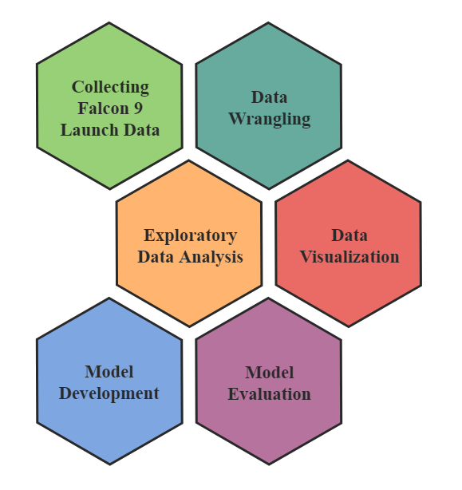
Executive Summary
Summary of Methodologies
The diagram outlines the phases of the Data Science Methodology applied in this project. All the data sets used were collected from public sources.
Summary of All Results
Exploratory Data Analysis Results
Interactive Analytics Dashboard
Predictive Analysis Results
Notes:
ill

Slide 4
Introduction
Project Background and Context
SpaceX is holding a remarkable position in the commercial space industry as a result of the low cost of launching a rocket. According to the company, the standard payment plan for a Falcon 9 launch is $62 million; while the cost of other providers exceeds $165 million. Much of the savings is because SpaceX can reuse the rocket's first stage.
Problems Analyzed
What determines whether a rocket will land successfully?
Which variables have the greatest influence on the landing success rate?
Can we estimate the cost of a launch by predicting whether the first stage will land?

Slide 5


Slide 6
Methodology
Data collection methodology
Data source: SpaceX REST API – HTTP Requests using Python Requests Library.
Data source: Wikipedia Article – Web scraping with Beautiful Soup Library.
Perform data wrangling
Dealing with missing values, one hot encoding, type cast, transform and cleaning features.
Perform exploratory data analysis (EDA) using visualization and SQL
Perform interactive visual analytics using Folium and Plotly Dash
Perform predictive analysis using classification models
Data standardization and data set splitting.
Hyperparameter tuning using Scikit-Learn's GridSearchCV.
Evaluation of Logistic Regression, Decision Tree, KNN and SVM classifiers algorithms.

Slide 7
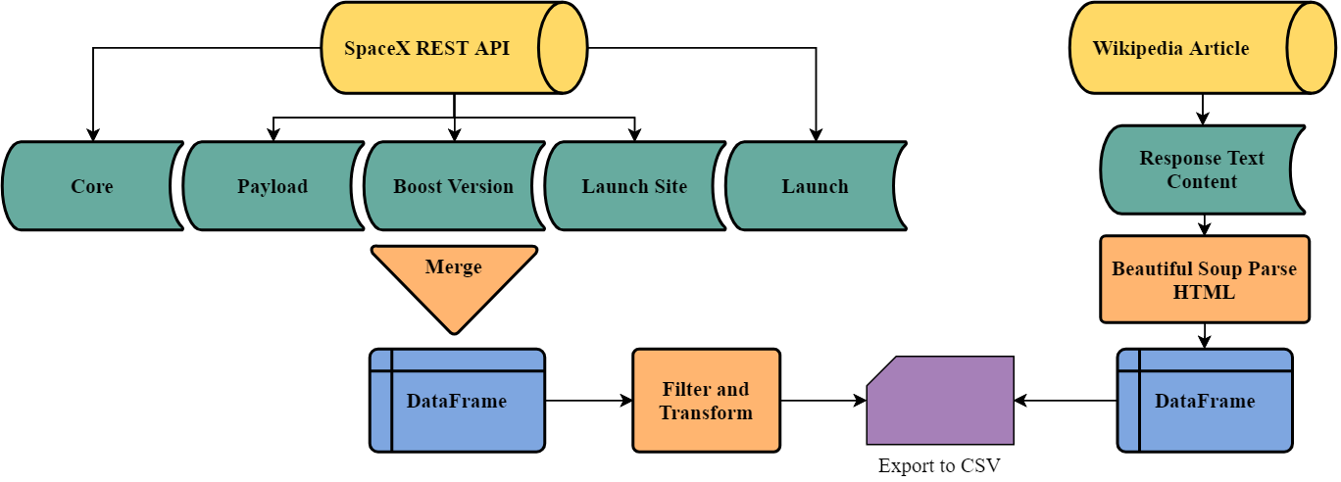
Data Collection
The data was collected from SpaceX public REST API, as shown in the flowchart below.
The second process shows how data from Wikipedia was collected through web scraping.

Slide 8
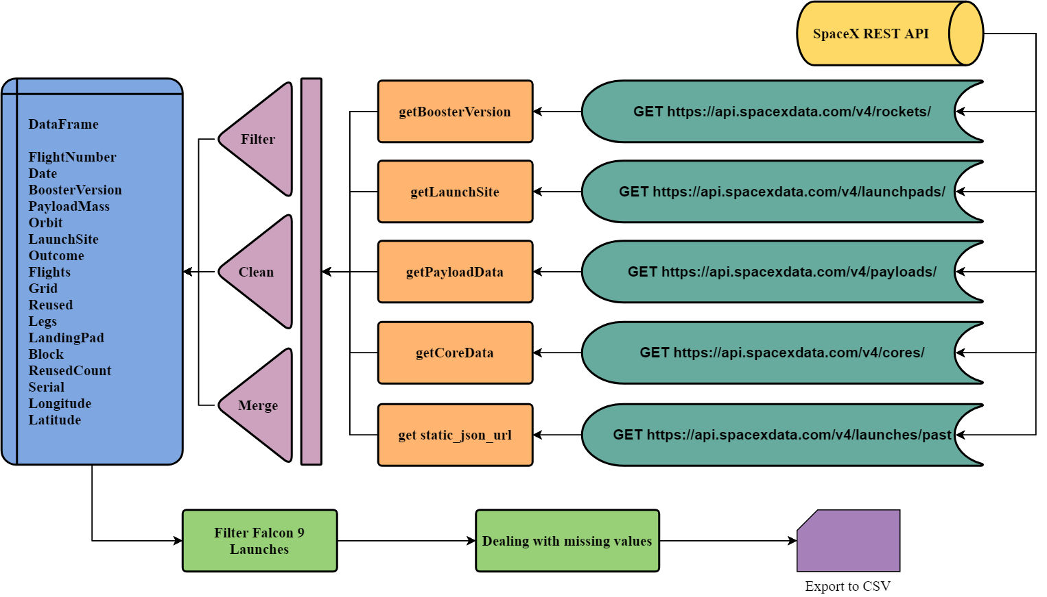
Data Collection – SpaceX API
Notebook
on Github

Slide 9
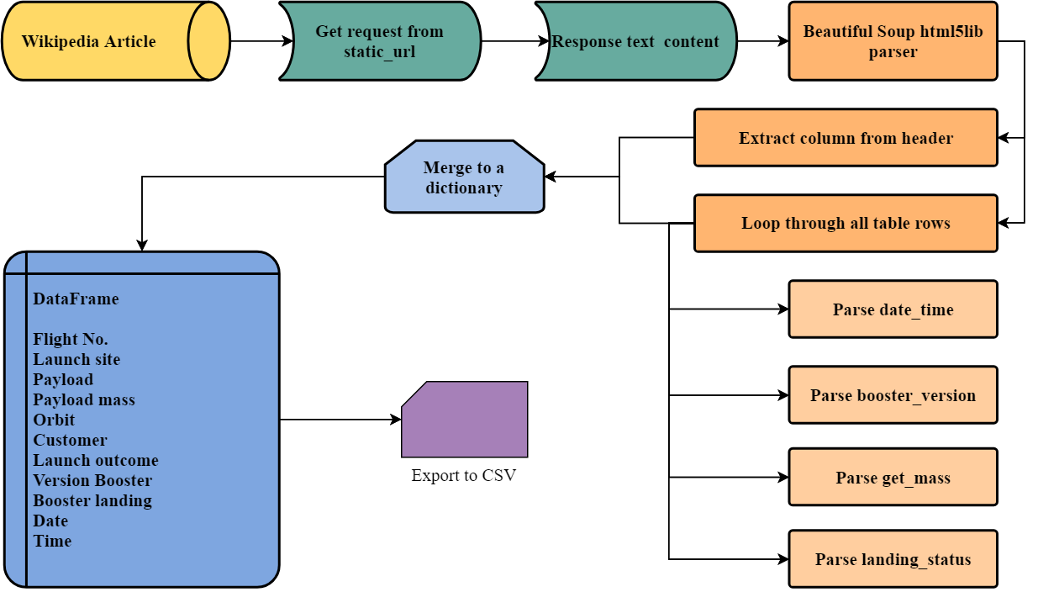
Data Collection – Web Scraping
Notebook
on Github

Slide 10
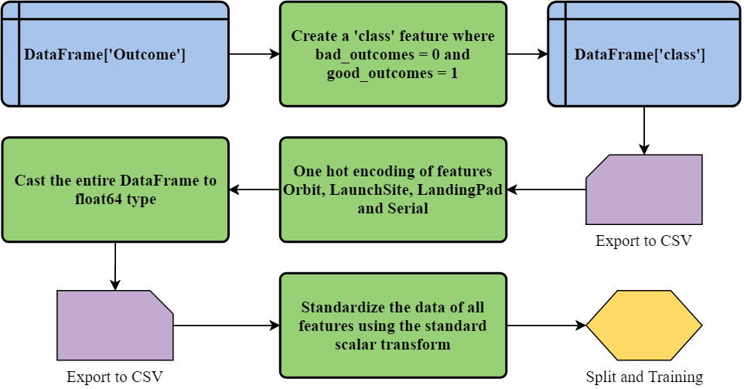
Data Wrangling
The first step was to create the 'class' feature from 'Outcome' as shown in the Notebook.
Than we performed one hot encoding of features and the type cast of the entire DataFrame to float as demonstrated in the Notebook.
Finally, the data of all features was standardized using a transform as presented in the Notebook.

Slide 11

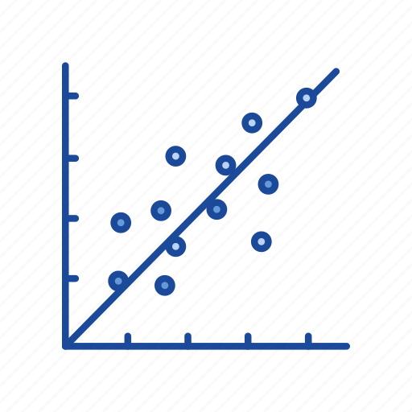

EDA with Data Visualization
Scatter Chart
Flight Number vs Payload Mass
Flight Number vs Launch Site
Payload Mass vs Launch Site
Orbit vs Flight Number
Payload Mass vs Orbit Type
Bar Chart
Orbit vs Success Rate
A bar chart or bar graph is a chart or graph that presents categorical data with rectangular bars with heights or lengths proportional to the values that they represent.
Line Chart
Success Rate vs Year
A scatter plot (aka scatter chart, scatter graph) uses dots to represent values for two different numeric variables. Scatter plots are used to observe relationships between variables.
A line chart is a visual comparison of how two variables— shown on the x- and y- axes —are related or vary with each other. It shows related information by drawing a continuous line between all the points on a grid.
Notebook on Github

Slide 12

EDA with SQL
Using SQL queries to answer questions about the data set.
Display the names of the unique launch sites in the space mission.
Display 5 records where launch sites begin with the string 'CCA'.
Display the total payload mass carried by boosters launched by NASA (CRS).
Display average payload mass carried by booster version F9 v1.1.
List the date when the first successful landing outcome in ground pad was achieved.
List the names of the boosters which have success in drone ship and have payload mass greater than 4000 but less than 6000.
List the total number of successful and failure mission outcomes.
List the names of the booster_versions which have carried the maximum payload mass.
List the failed landing_outcomes in drone ship, their booster versions, and launch site names for in year 2015.
Rank the count of landing outcomes between the date 2010-06-04 and 2017-03-20, in descending order.
Notebook
on Github

Slide 13
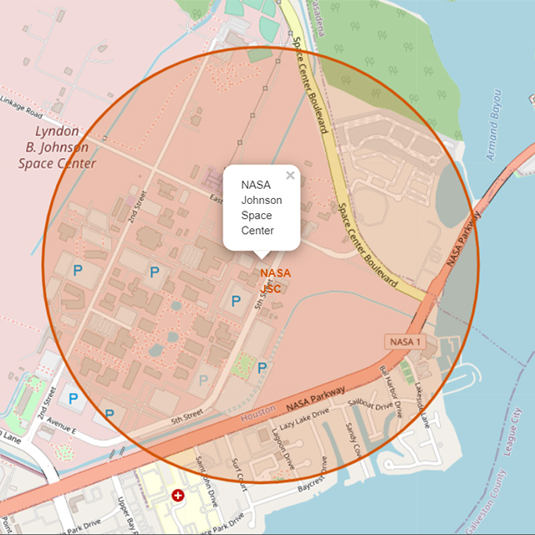
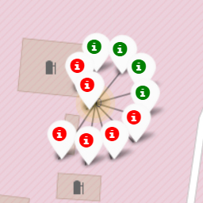
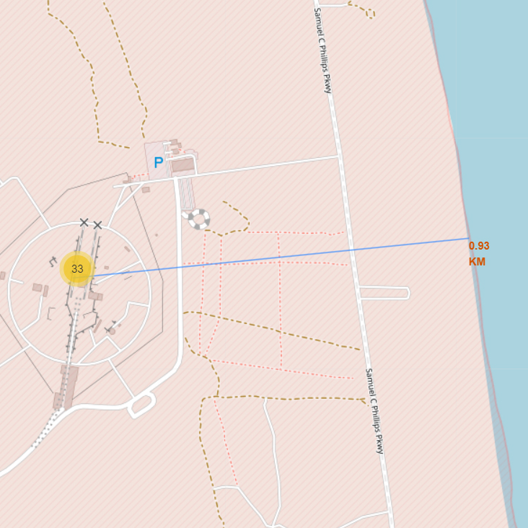
Build an Interactive Map with Folium
We marked NASA and all launch sites (CCAFS LC-40, CCAFS SLC-40, KSC LC-39A, VAFB SLC-4E) on a Map using a Circle with a Popup and a Marker object to analyze their locations in relation to each other.
Then we added the launch outcomes for each site to identify which location have high success rates. For each SpaceX launch we created a Marker with a green Icon for success and red Icon for failure. The markers where added to a MarkerCluster object.
Finally, we used the MousePosition object to get the coordinates of several points of interests (such as a railway, highway, city and coastline). The distance from the point to the launch site was calculated, a Polyline was draw and added to the Map.
Notebook on Github
Notebook on NbViewer
* GitHub blocks folium content

Slide 14



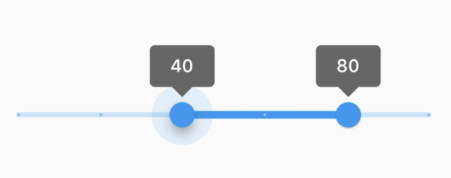
Build a Dashboard with Plotly Dash
The dashboard was build using the Dash framework and deployed on Google Cloud Platform. You can review the live application here and the source code on Github.
The first interactive component is a Dropdown list, where you can select all sites or any specific launch site to plot the graphs for.
A Pie Chart is shown according to the selected option. Each slice on this graph represents the total of successful launches per site or the success / failure ratio.
Then a Scatter Plot is displayed, where the launch outcome in relation to the payload mass can be analyzed. Each point on this graph is colored according to the booster version label on the right side.
Finally, you can switch the RangeSlider on top of the Scatter Plot to analyze the results for different payload mass values.

Slide 15
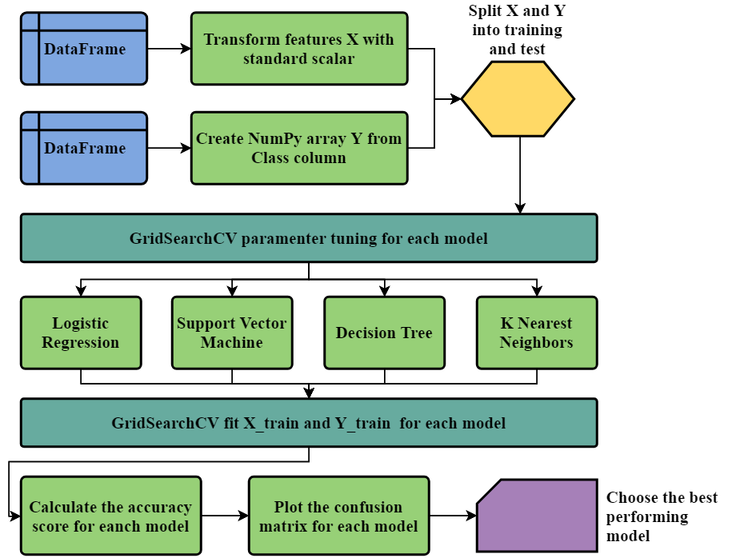
Predictive Analysis (Classification)
The data sets were loaded from csv files, transformed and split into training and test.
The model was built applying four different classification algorithms from the Scikit-learn library.
The GridSearchCV was used to select the best parameters for each model.
All algorithms were evaluated using the accuracy score and the confusion matrix.
Notebook on Github

Slide 16
Results
Exploratory data analysis results
Interactive analytics demo in screenshots
Predictive analysis results

Slide 17


Slide 18
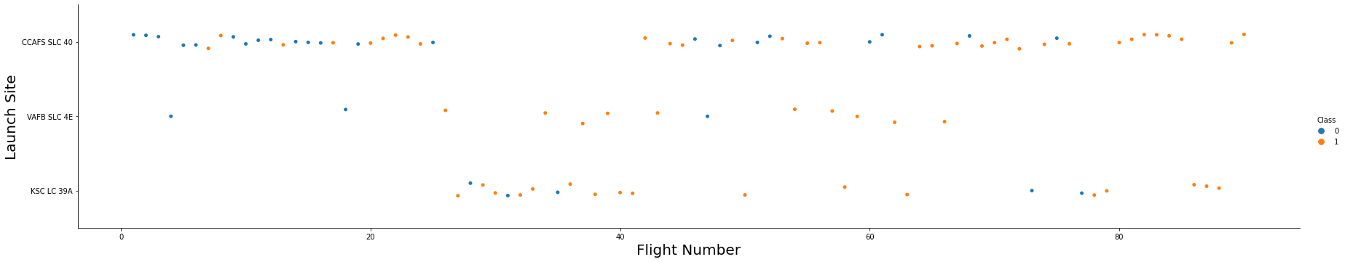
Flight Number vs. Launch Site
According to the Scatter Plot below, it is possible to notice that the success rate of a launch increased with time.
Furthermore, it is evident that both CCAFS SLC 40 and KSC LC 39A accumulate more launches and have similar success rates.
Notebook on Github

Slide 19
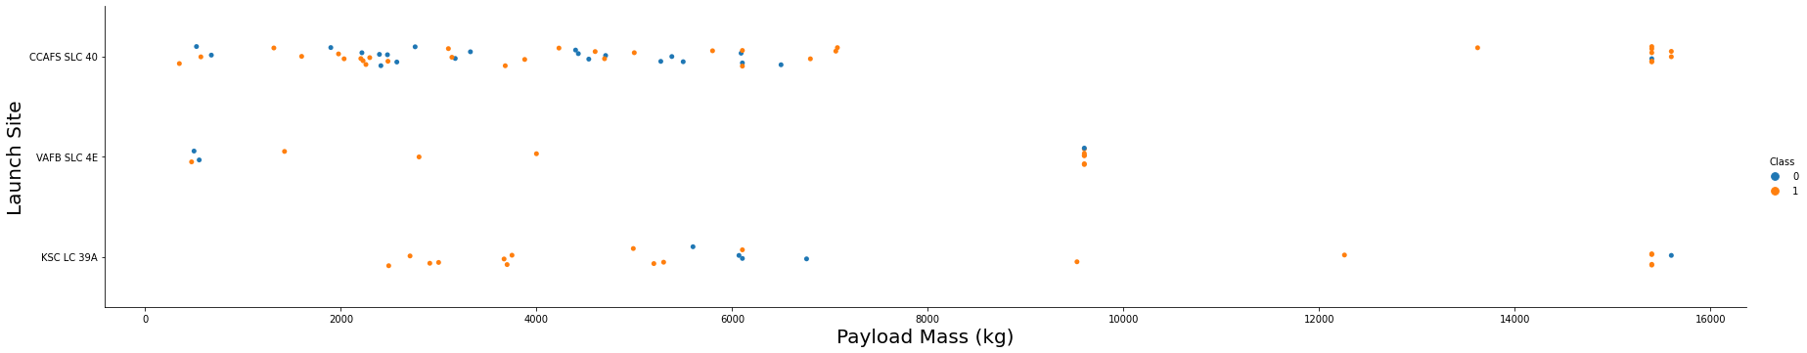
Payload vs. Launch Site
The graph shows that the success rate for all launch sites are higher when the payload mass is greater than 8000 kg. However, this does not mean that mass is the only variable that establishes a causality.
The majority of successful launches were carrying a payload mass between 2000 kg and 6000 kg.
Notebook on Github

Slide 20
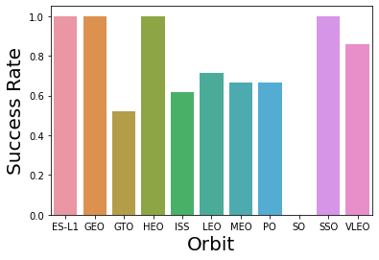
Success Rate vs. Orbit Type
The Bar Chart shows that the maximum success rate was settled by the ES-L1, GEO, HEO and SS0 orbits.
The GTO orbit hit the lower success mark, while the others score around 70% in average.
Notebook on Github

Slide 21
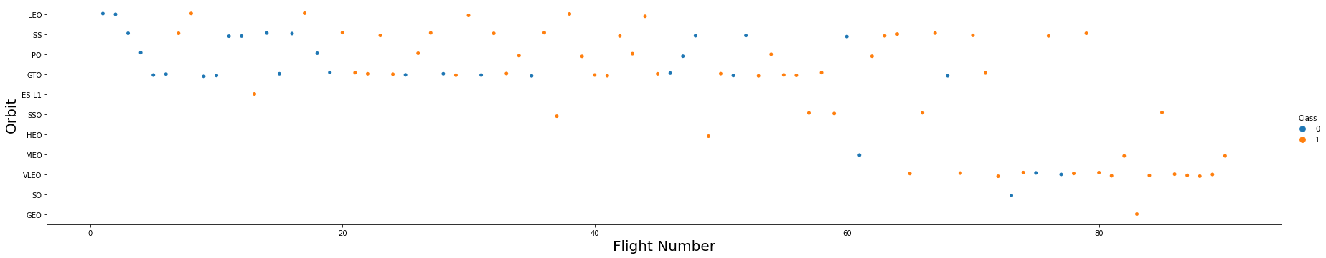
Flight Number vs. Orbit Type
In this graph it is possible to notice that the SSO orbit hit the 100% success rate with five launches. All the others have only one flight.
In addition, it is clear that most of the launches were destined to the ISS, PO, GTO and VLEO orbits. These four orbits together have approximately 65% ​​average success rate.
Notebook on Github

Slide 22
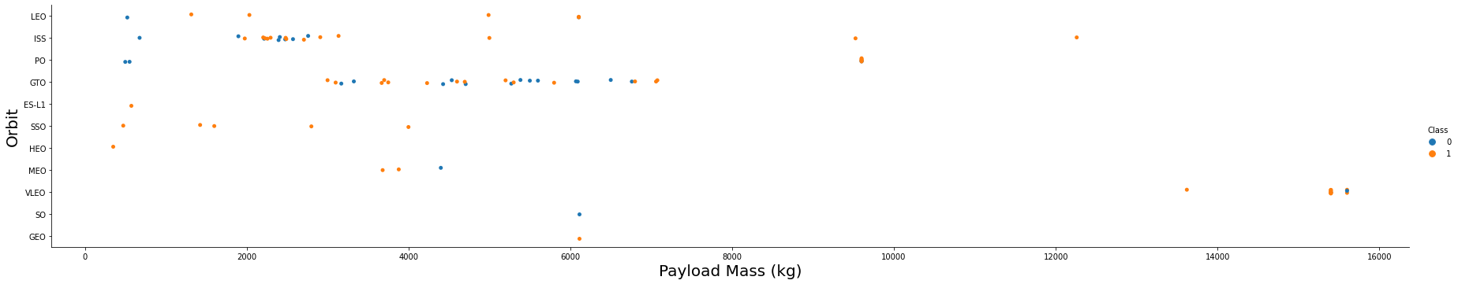
Payload vs. Orbit Type
The analysis of the graph allows us to observe that the success rate is near 100% for ISS, PO and VLEO orbits when the payload mass exceeds 8000 kg.
Most successful launches were carrying a payload between 2000 kg and 6000 kg. In the graph you notice a greater concentration of points in the ISS and GTO orbits.
Notebook on Github

Slide 23
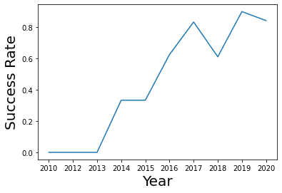
Launch Success Yearly Trend
The success rate of Falcon 9 launches has grown continuously over the period 2013-2020.
Notebook on Github

Slide 24
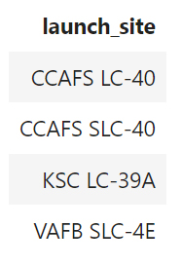
All Launch Site Names
The DISTINCT statement was used to return only unique values from the launch_site column.
select distinct LAUNCH_SITE from SPACEXTBL;
Notebook on Github

Slide 25
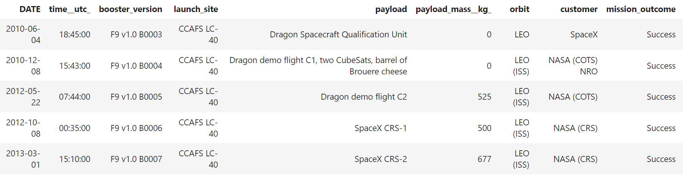
Launch Site Names Begin with 'CCA'
The query statement uses the wildcard % after CCA meaning that only the values beginning with CCA will match the condition of the WHERE clause. The number of rows returned will be limited by 5.
select * from SPACEXTBL where LAUNCH_SITE like 'CCA%' LIMIT 5;
Notebook on Github

Slide 26
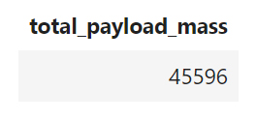
Total Payload Mass
The query statement uses the built-in function SUM to calculate to total payload mass for the customer NASA (CRS) filtered by the WHERE clause.
select sum(PAYLOAD_MASS__KG_) as TOTAL_PAYLOAD_MASS from SPACEXTBL
where CUSTOMER = 'NASA (CRS)';
Notebook on Github

Slide 27
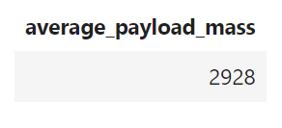
Average Payload Mass by F9 v1.1
The query statement uses the built-in function AVG to calculate the average payload mass for flights with version F9 v1.1 of the booster, filtered by the WHERE clause.
select avg(PAYLOAD_MASS__KG_) as AVERAGE_PAYLOAD_MASS from SPACEXTBL
where BOOSTER_VERSION = 'F9 v1.1';
Notebook on Github

Slide 28
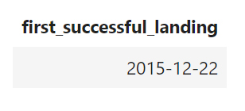
First Successful Ground Landing Date
The query statement uses the wildcard % after Success, meaning that only the values beginning with Success will match the condition of the WHERE clause. The built-in function MIN is used to return only the lowest date value, which represents the first occurrence of a success.
select min(DATE) as FIRST_SUCCESSFUL_LANDING from SPACEXTBL
where LANDING__OUTCOME like 'Success%';
Notebook on Github

Slide 29
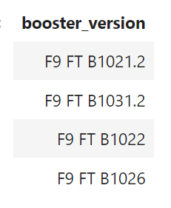
Successful Drone Ship Landing with Payload between 4000 and 6000
The DISTINCT statement was used to return only unique values from the booster_version column. The WHERE clause was used to filter records that fulfill the following condition: boosters which have success in drone ship and have payload mass greater than 4000 but less than 6000.
select distinct BOOSTER_VERSION from SPACEXTBL
where LANDING__OUTCOME = 'Success (drone ship)' and
PAYLOAD_MASS__KG_ < 6000 and PAYLOAD_MASS__KG_ > 4000;
Notebook on Github

Slide 30
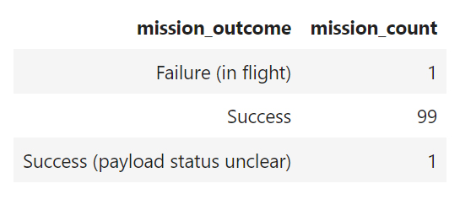
Total Number of Successful and Failure Mission Outcomes
The GROUP BY statement groups rows that have the same values for the mission outcome. Then the built-in function COUNT is used to return the number of rows for each category (or group) of mission outcome.
select MISSION_OUTCOME, count(MISSION_OUTCOME) as MISSION_COUNT
from SPACEXTBL GROUP BY MISSION_OUTCOME;
Notebook on Github

Slide 31
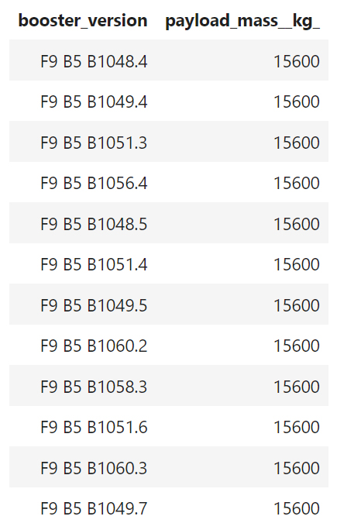
Boosters Carried Maximum Payload
This query uses a subquery to set the condition for the WHERE clause. The built-in function MAX is used to find the maximum value of the payload mass. Then the value returned by the subquery is used to filter the values of the booster version.
select BOOSTER_VERSION, PAYLOAD_MASS__KG_
from SPACEXTBL
where PAYLOAD_MASS__KG_=
(select max(PAYLOAD_MASS__KG_)
from SPACEXTBL);

Slide 32
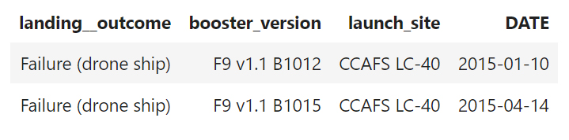
2015 Launch Records
The WHERE clause in this statement is used to filter by two conditions. The first is a failed landing outcome in drone ship. The second uses the built-in function YEAR to match only the dates where the year is 2015.
select LANDING__OUTCOME, BOOSTER_VERSION, LAUNCH_SITE, DATE
from SPACEXTBL
where LANDING__OUTCOME = 'Failure (drone ship)' and year(DATE) = 2015;
Notebook on Github

Slide 33
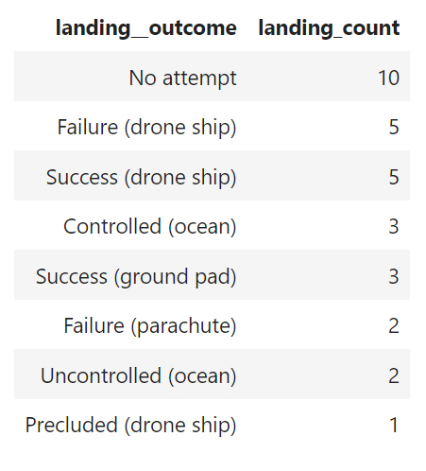
Rank Landing Outcomes Between 2010-06-04 and 2017-03-20
This query uses the group by statement and the built-in function COUNT to calculate the number of landing outcomes. The WHERE clause is used to filter by date and the ORDER BY keyword sorts the result set in descending order.
select LANDING__OUTCOME,
count(LANDING__OUTCOME) as LANDING_COUNT
from SPACEXTBL
where DATE between '2010-06-04' and '2017-03-20'
GROUP BY LANDING__OUTCOME
ORDER BY LANDING_COUNT DESC;
Notebook on Github

Slide 34


Slide 35
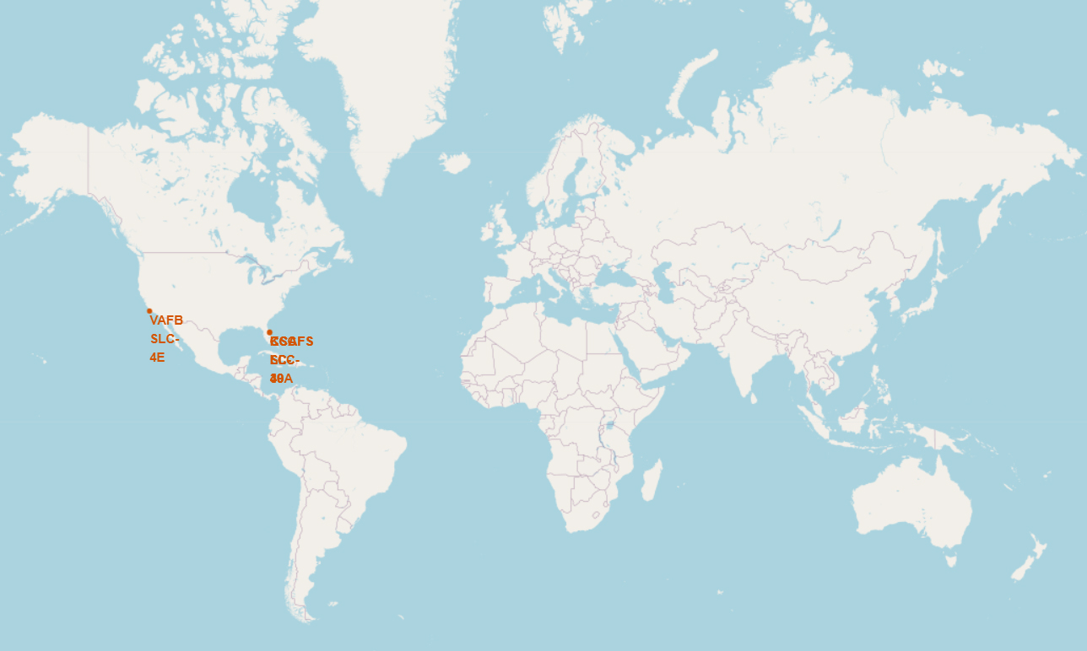
SpaceX Launch Sites Locations
All launch sites are located in the United States of America.
Their latitude is just above the Tropic of Cancer.
All four space complexes are based on the coastline of California and Florida.
Notebook on NbViewer

Slide 36
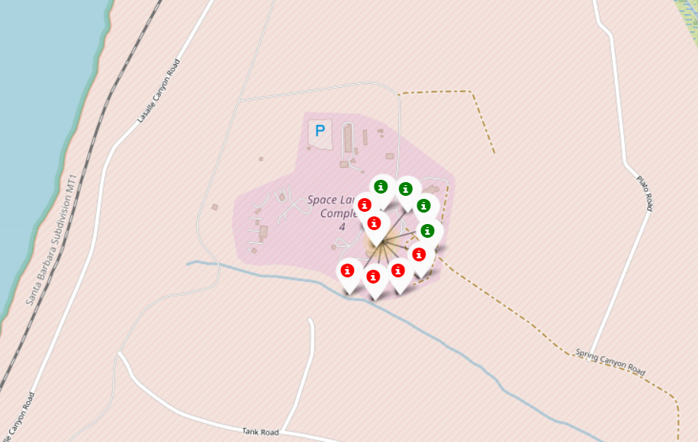
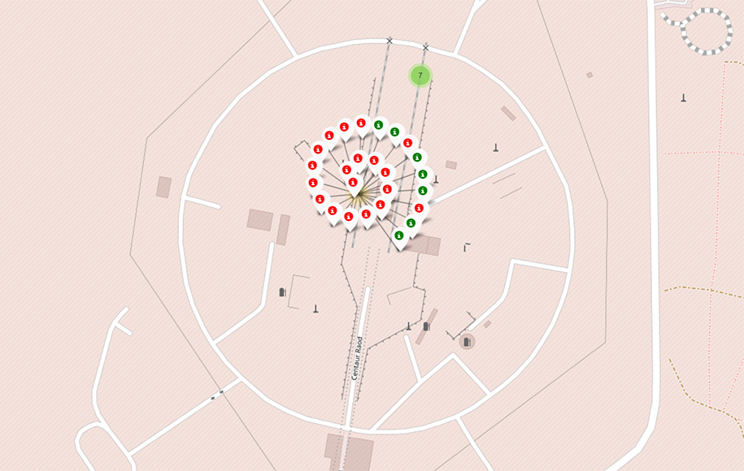
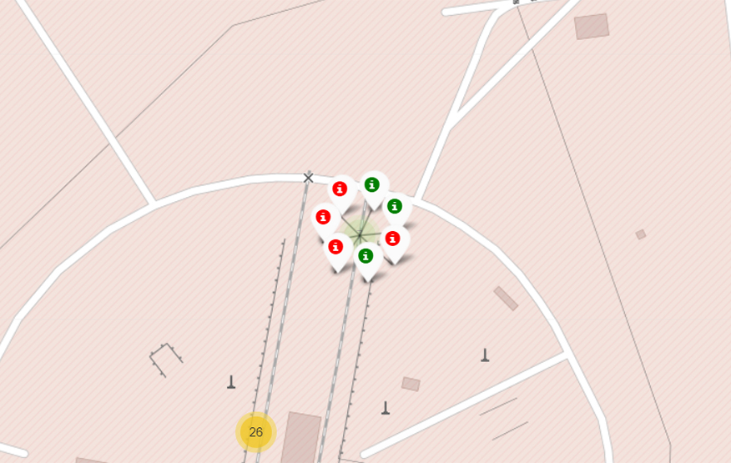
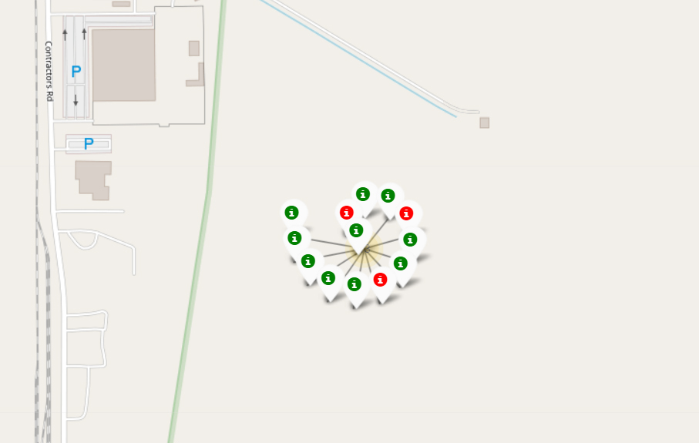
Marks of Success and Failure Launches
The marks on the map indicate that launch success rate is higher for the Kennedy Space Center (KSC LC-39A).
Success Launch Failure Launch
Notebook
on NbViewer
CA
VAFB SLC-4E
FL
CCAFS LC-40
FL
CCAFS SLC-40
FL
KSC LC-39A

Slide 37
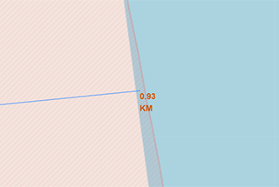
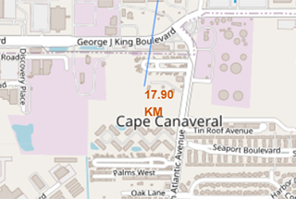
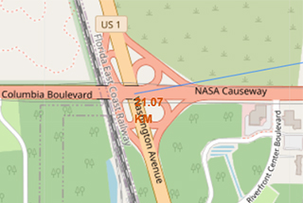
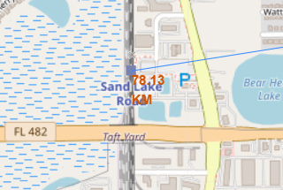
Distance from the Launch Complex CCAFS LC-40
The Cape Canaveral Space Launch Complex is extremely close to the shore and is located at a reasonable distance from the nearest city and the nearest highway.
However, it is relatively far from the Sand Lake Road train station.
0.93 Km
Coastline
Notebook on NbViewer
17.9 Km
City of Cape Canaveral
21.07 Km
US Highway 1
78.13 Km
Railway

Slide 38


Slide 39
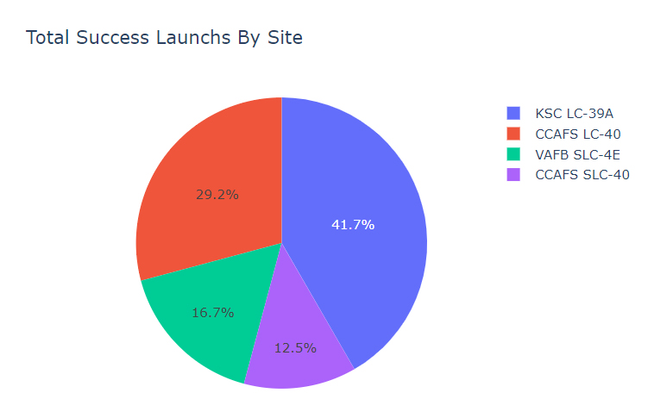
Total Success Launches by Site
The pie chart validates previous information, gained from the map markers, that the KSC launch complex has the highest success rate.
It also indicates a trend, when compared to the number of markers on the map, of a linear relationship between success rate and the number of flights per site.
Live Dashboard

Slide 40
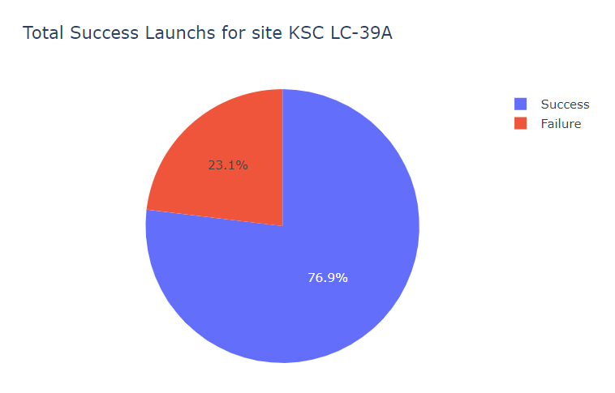
Total Success Launches for Kennedy Space Center
Despite having the highest number of successful launches and the highest success rate, there is no clear evidence that the location is the only reason for the outcome.
Live Dashboard

Slide 41
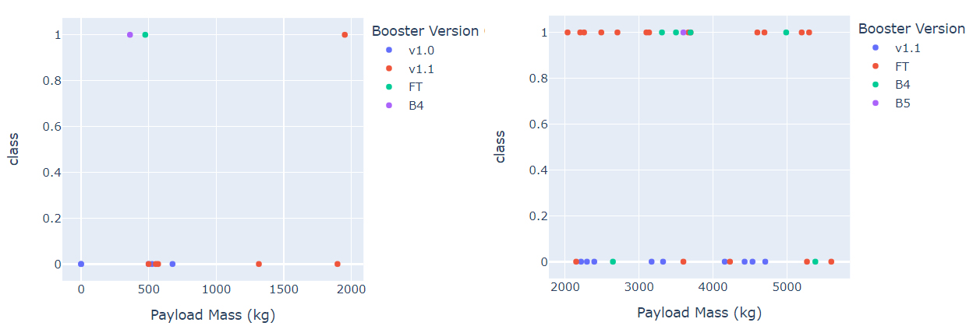
Launch Outcome by Payload Mass
In the first range of payload mass, lower than 2000 kg, there is a higher failure rate and the booster version v1.1 is the most used.
In the second range of payload mass, between 2000-6000 kg, the success rate is approximately 52% and the booster version FT is the most used and successful.
Live Dashboard

Slide 42


Slide 43
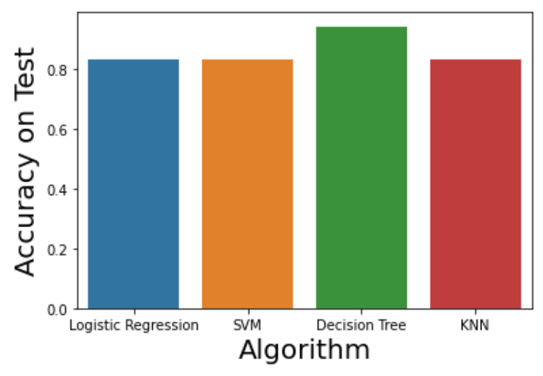
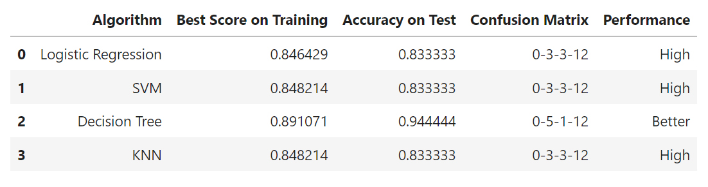
Classification Accuracy
The accuracy scores indicate that the performance improvement brought by the GridSearchCV resulted in identical values for Logistic Regression, SVM and KNN algorithms.
Finally, we have a clear winner that performed better on both training and test scores. The Decision Tree algorithm satisfies the requirements of this project.
Notebook on Github

Slide 44
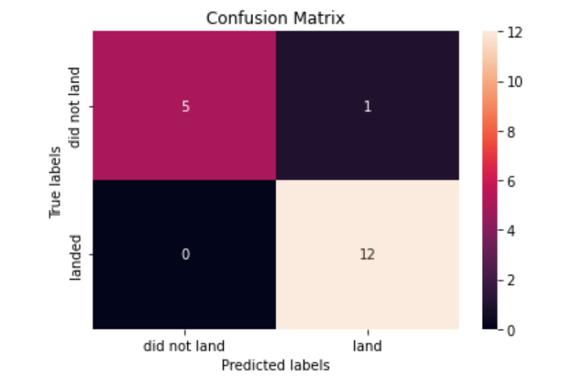
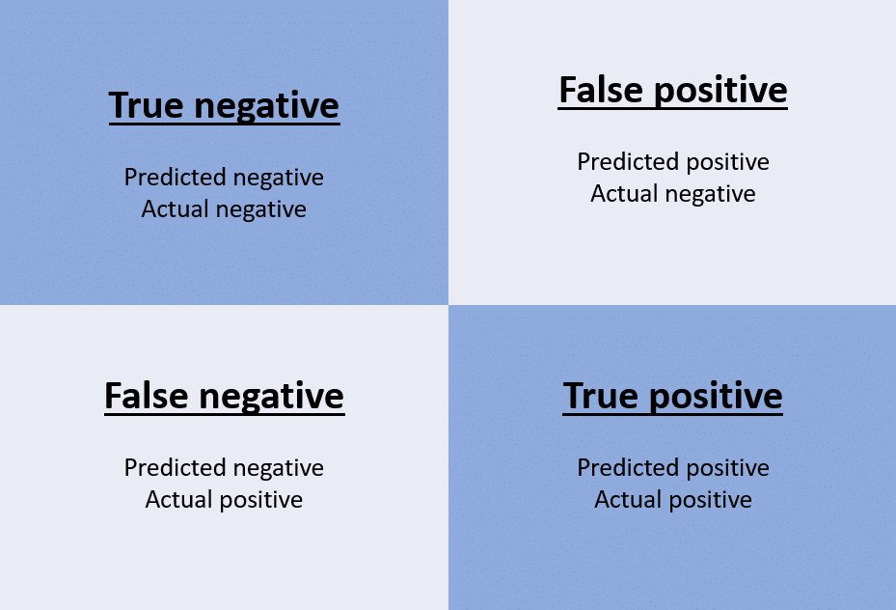
Confusion Matrix for the Decision Tree
The confusion matrix shows that, given a test set of 18 records, we got 17 correct predictions and only 1 incorrect.
The incorrect prediction is a false positive, also known as a type I error, false alarm or overestimation.
Notebook on Github

Slide 45
Conclusions
What determines whether a rocket will land successfully?​
The most important factor is time. The success rate of Falcon 9 launches has grown continuously over the period 2013-2020.
Which variables have the greatest influence on the landing success rate?​
The Kennedy Space Center (KSC LC-39A) has the highest success rate of 76.9%.
A payload mass between 2000 kg and 6000 kg is most likely to give a positive outcome.
Most of the launches were destined to the ISS, PO, GTO and VLEO. These four orbits together have approximately 65% average success rate.
The new booster versions contributed to a significant improvement in the success rate.
Can we estimate the cost of a launch by predicting whether the first stage will land?
According to the predictive analysis results it is possible, with a satisfactory confidence margin, to estimate costs based on launch data.

Slide 46
Appendix – Resources, Tools and Services
Python Libraries
Matplotlib
Seaborn
Pandas
NumPy
Plotly Dash
Scikit-learn
Tools
Visual Studio Code
MS PowerPoint
Adobe Photoshop
Services
IBM Cloud
GitHub
Google App Engine

Slide 47


